Slide 1
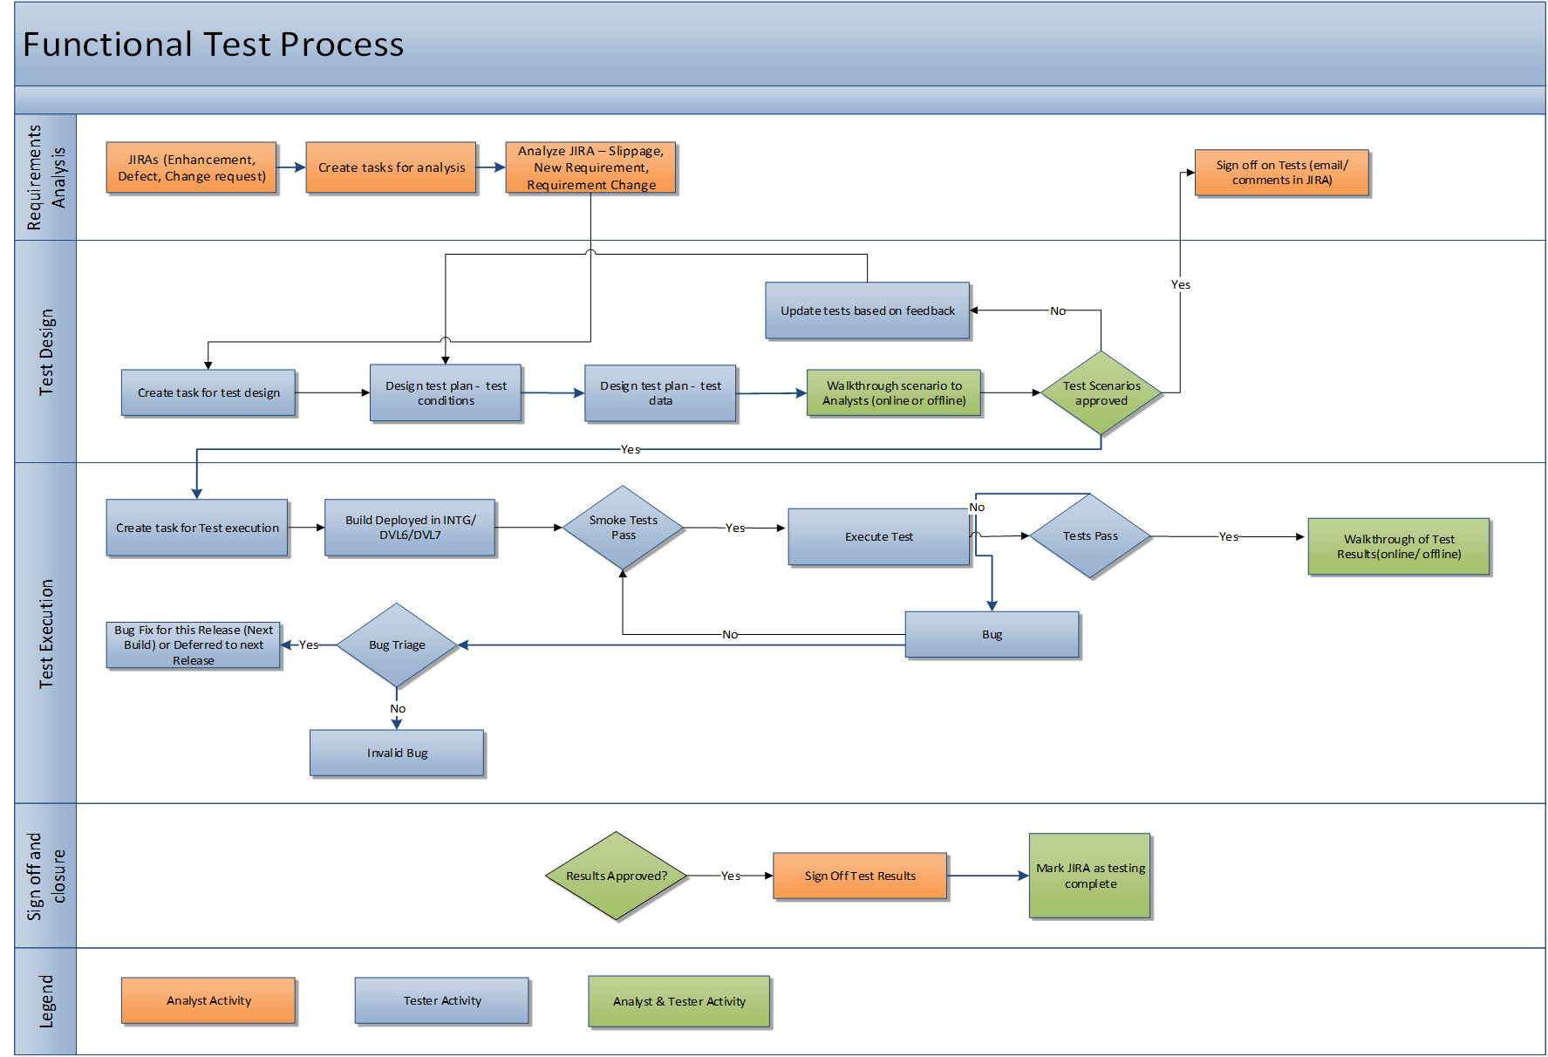

QA Functional Test Process
1

Slide 2
QA Functional Test Process – Contd..
QA team start the analysis on the requirements or JIRA once it is identified for the release after JIRA prioritization (tagged to a particular APD release in JIRA tool with “Fixed Version”)
Create appropriate tasks in TFS for QA team effort
Walkthroughs and clarifications on the Test Scenarios and obtain Analysts sign-off
Create Test cases in MTM (new or update existing tests)
Identify Test data based on test cases / scenarios
Perform smoke tests on the new builds deployed for testing
Perform Functional Testing for JIRAs mapped to current APD release
Upload Test artifacts in MTM & JIRA
Defect logging and triaging
Publish test status
2

Slide 3
QA Regression Test Process
3

Slide 4
QA Regression Test Process – Contd..
Identify Regression Test candidates / Test cases
Create appropriate tasks in TFS for QA team effort
Automate identified automatable regression test cases
Update the existing regression test cases as applicable
Identify test data based on test cases / scenarios
Perform smoke tests on the new builds deployed for testing
Perform Regression Testing across functional areas
Defect logging and triaging
Publish Regression Test Results
Continuous Optimization of Regression test suite
4

Slide 5
Defect Management Process
5

